Slide 1




Infrastructure Migration & Modernization
[put partner or customer logo here]
Month and Year

Slide 2



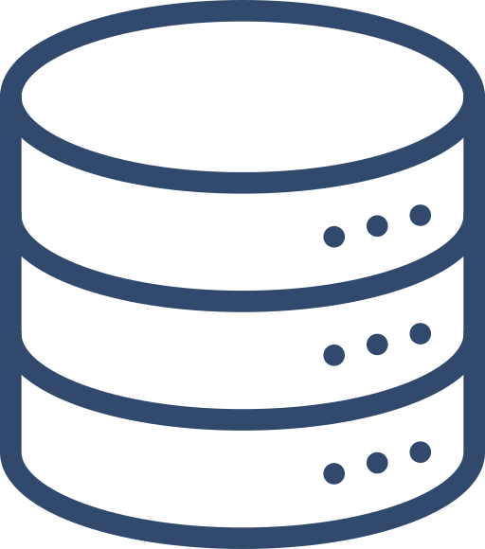













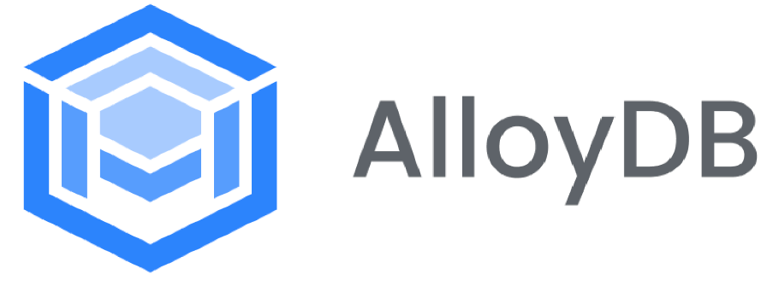



About Onix
20+ years of propelling enterprise value for our customers
5/top 10
Telecom Customers
5/top 10
Healthcare & Life Science Customers
5/top 10
Retail Customers
App & Data Specialist
IP-Based Solutions
Enterprise Grade AI
Generative & Predictive Solutions Powered by our IPs
100% guaranteed migration and modernization to cloud-based data warehouse
3X faster time to value
Available on Cloud Marketplace
Synthetic Data Generator
LLM Fine Tuning
AI Model Training
Hallucination guard
Accuracy engine
Context aware engine
5/top 10
Banking Customers
5/top 10
Media & Entertainment Customers
5/top 10
Insurance Customers
103 / Fortune 500 are Onix customers
Eagle
The Planner
Condor
The Transporter
Raven
The Transformer
Pelican
The Validator
Kingfisher
Synthetic Data
Phoenix
AI Studio
Eagle Finops
The Planner
Onix Wingspan Platform
Google Launch Partner
Global Coverage with over 1,500+ Customers
30+ IPs for your Data, AI and Cloud Journey
60+ Industry Solutions
Agentspace

Slide 3










Onix IP Driven Propositions
Infrastructure Modernization
Intelligent Ops with Active Assist
Fast paced Migration Factory with ~400 assets per week guaranteed
Onix Swift Migrator for Cloud or on-premises migration to Cloud
Expertise in migrating over 1M+ assets to cloud
Swift AIVision for intelligent Ops across platforms.
Guaranteed outcomes for KPIs which matter
Accelerated workflows for proactive remediation
Automation for Top 4 ISVs
Cross-Cloud
Network & Air Gap
Swift Integrator for Hybrid and Multi-cloud interoperability
Specialization in Google Distributed Cloud and Air-Gapped environments
Intelligent Network Automation for proactive network insights and optimization
AI Based Network Rule Engine
Virtual Desktops
Swift Integrator and Migrator for migration and modernize of microsoft workloads to cloud
Onix IPs and automated playbooks for migrating workloads to Cloud
NIST-800-207 inspired security hardened OS templates and deployment profiles
50+ Persona based User Desktop Profiles for each Industry with desired security config
Deep expertise in implementing Zero Trust Architecture using Google’s native tools
Onix IPs & tools for migration & transformation of workloads
Deep expertise in migrating IBM openshift & websphere to Google Cloud native

Slide 4






Onix IP Driven Propositions
Modernize Traditional Apps
Intelligent Apps
on Edge
Reusable libraries and playbooks to Accelerate time to value
Onix Swift Migrator for containerization
Raven IP for Application Code conversion
Swift AIVision for optimized edge inferencing
Standardized architectures for real-time analytics and IoT-driven intelligence
Intelligent caching & model compression techniques to improve edge performance
Modern Software Delivery
New Cloud Native LOB App Development
Deep expertise in SLSA security framework
Prebuilt DevOps Accelerators for rapid deployment
Engineered bird IPs to elevate customer delivery with Onix specialized expertise
Everything as a Service (XaaS) approach for cloud native applications
Expertise in UI/UX design to elevate your brand and enhance user satisfaction
Industry-specific solution Accelerators
AI First (Adaptive Apps), Geospatial Apps, Multi-touch, Metaverse
Low Code / No Code Apps
2000+ Projects Delivered on Digital Workplace
Accelerators with ready-to-use workflows and pre built connectors for rapid deployment.
Empower citizen developers with access to an extensive Onix Workspace Libraries for seamless automation.

Slide 5





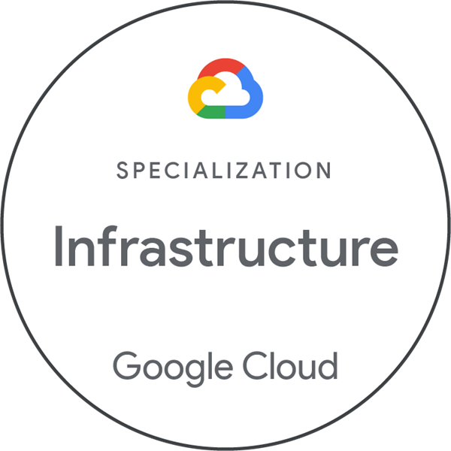
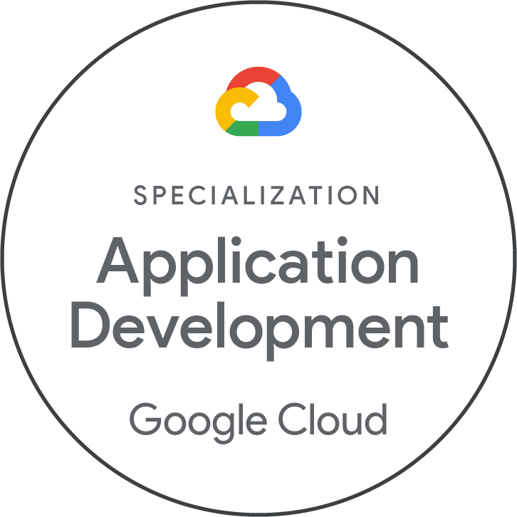
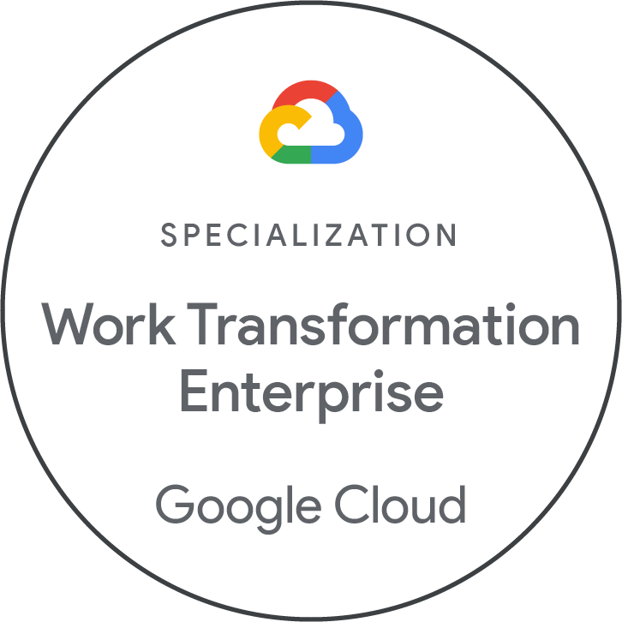
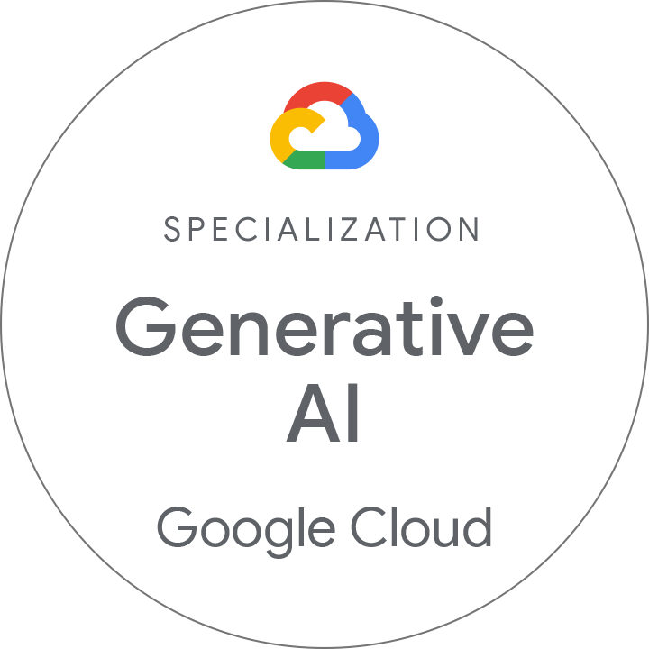
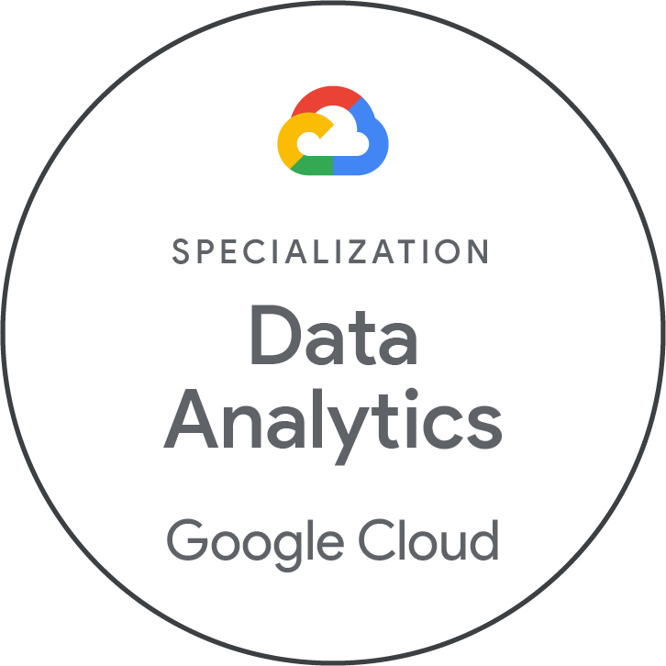
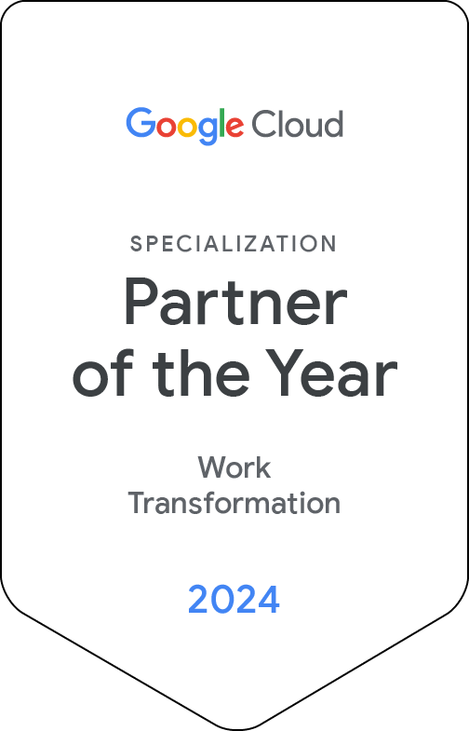
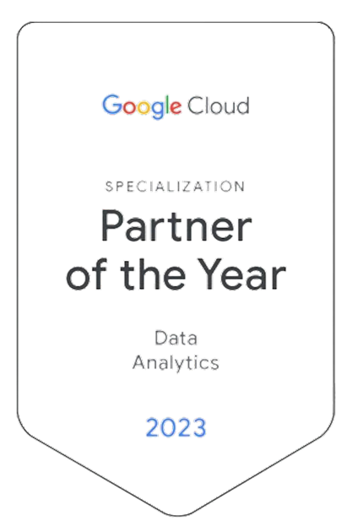

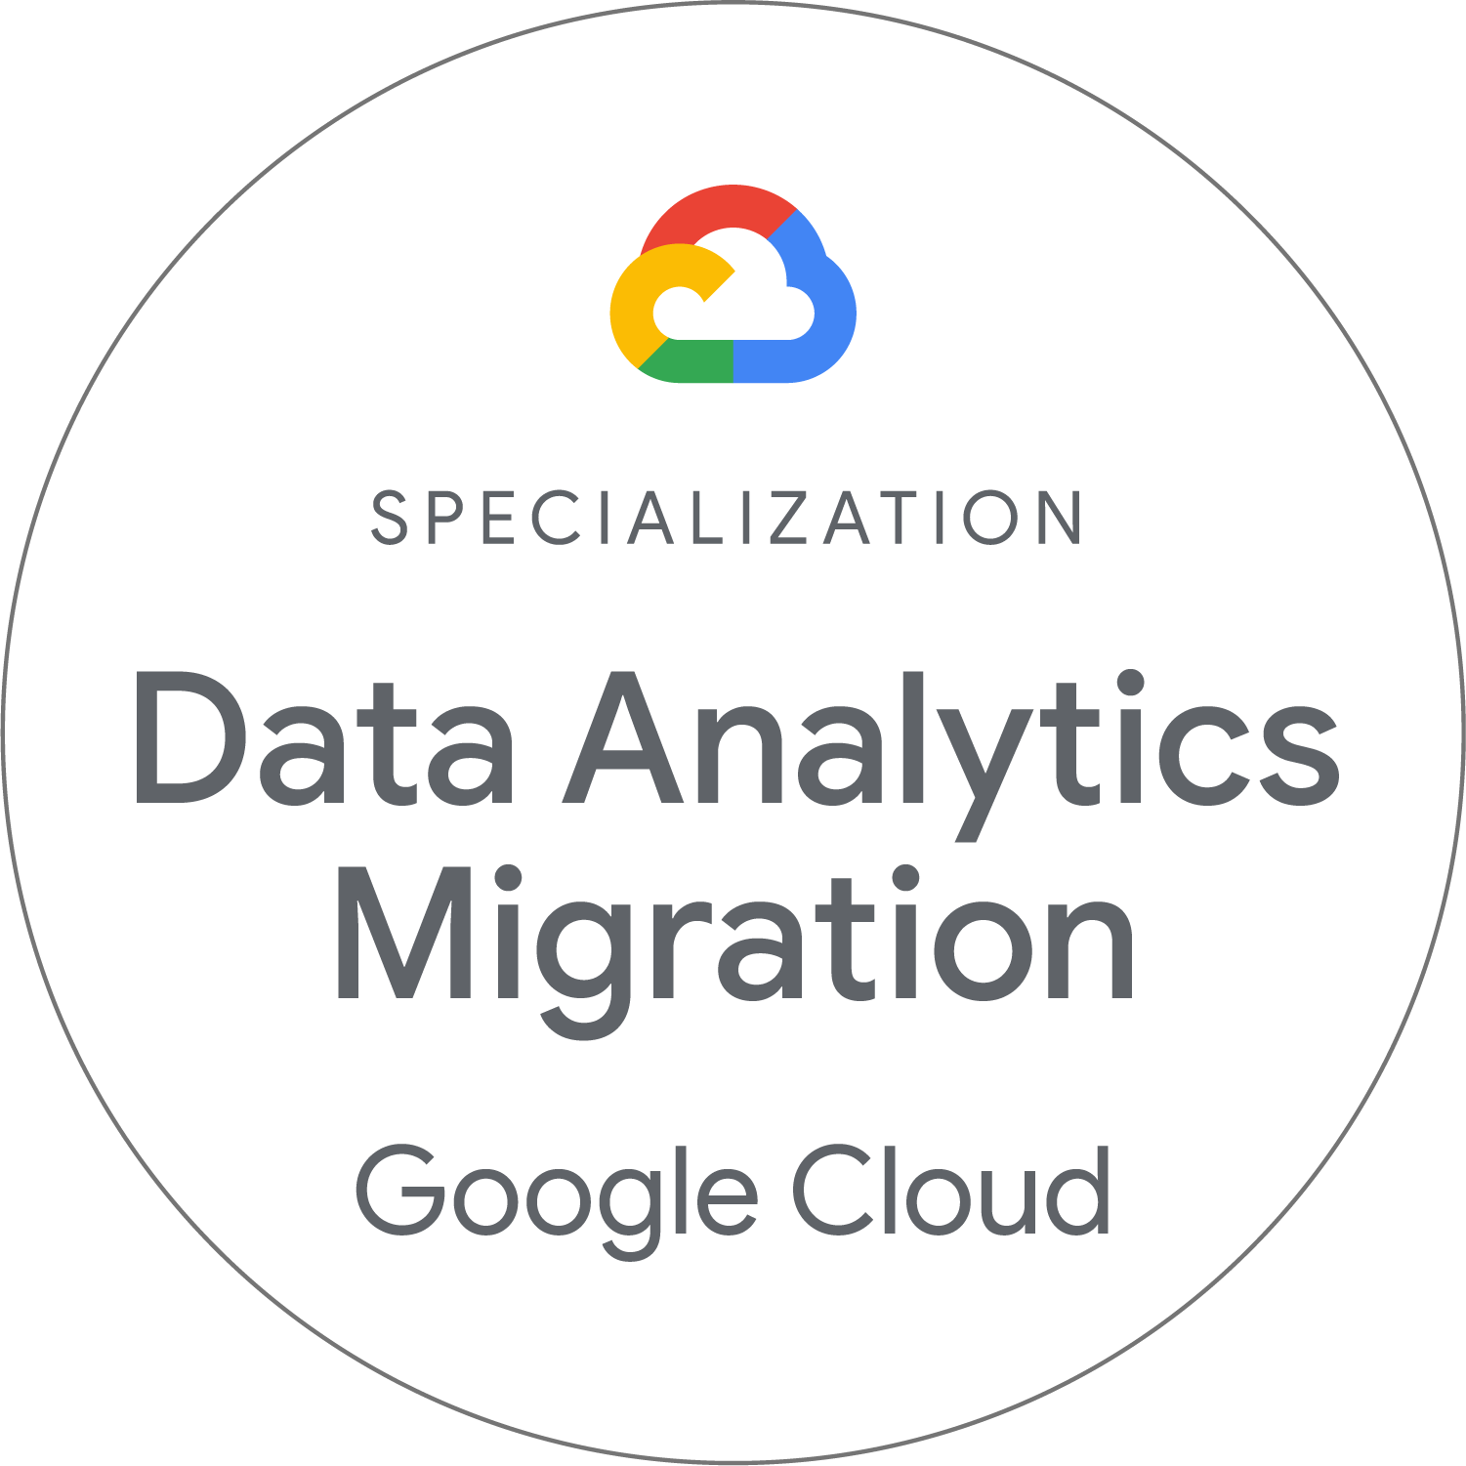
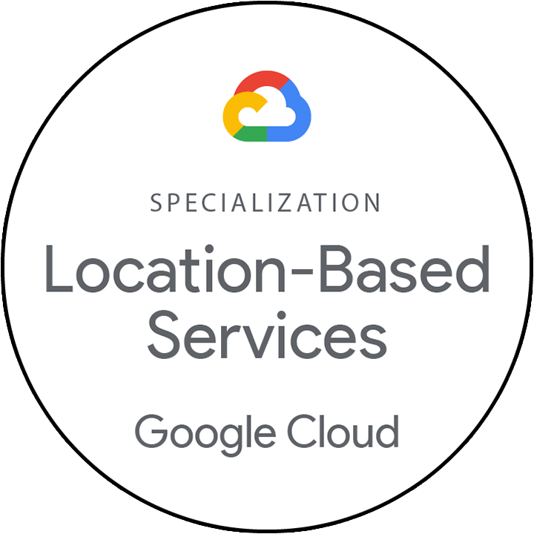

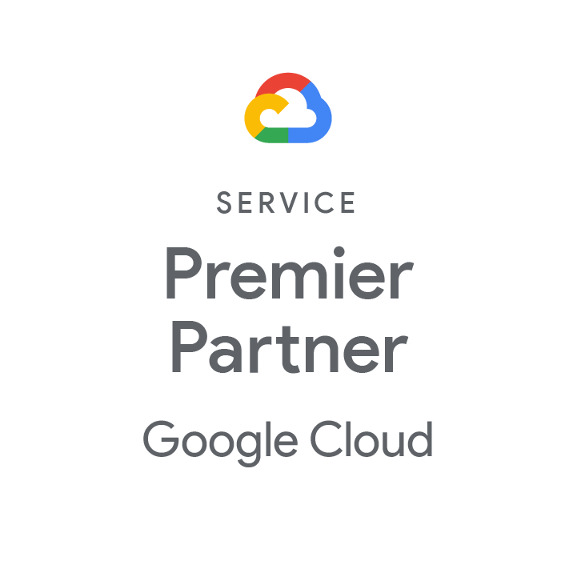
Onix Differentiators
Business Value
IP & Accelerators
Our People
Our Expertise
Fast paced Migration Factory with ~400 assets per week guaranteed
Near Zero Downtime for migration using Onix IPs
Guaranteed outcomes for KPIs which matter
“Automation First” approach to Accelerate time to value
Onix Wingspan Platform with Patented Accelerators
Agentic AI for Intelligent Ops across on-premise + edge + cloud
Swift Cloud Migrator for Zero Touch Migrations
Swift Migrator for ISV to Cloud Native Monitoring
Ex-Googlers, Ex-AWS, Ex-Microsoft with rich experience in Migration & Modernization
Experienced Industry & large Enterprise hires
Center of Excellence and global delivery
Flawlessly migrated over 1M+ assets by our experts
Leading Google AI Partner with over 200+ Infra projects in production
Alpha, Early Adopter and Launch partner for Google: DC Takeout, IaC
Industry recognition for driving thought leadership in Infra as Code

Slide 6
Onix Differentiators
Business Value
IP & Accelerators
Our People
Our Expertise
Rapid Innovation and time to market using AI first approach
Everything as a Service (XaaS) approach for cloud native applications
Guaranteed outcomes for KPIs which matter
“Reusable libraries” to Accelerate time to value
Onix Wingspan Platform with Patented Accelerators
Agentic AI for Intelligent Ops across applications
Swift Launchpad for modern software delivery
Raven IP for Application code conversion
Ex-Googlers, Ex-AWS, Ex-Microsoft with rich experience in Application Modernization
Experienced Industry & large Enterprise hires
Center of Excellence and global delivery
Leading Google AI Partner with over 200+ Infra projects in production
Specialized Partner for Application Development
Industry recognition for driving thought leadership in Security as Code

Slide 7
Our Understanding
Current Landscape
In Scope
xxx: yyyy, distributed across two on-premises data centers.
xxxx.

Slide 8
Out of Scope & Assumptions
Out of Scope
Assumptions
xxxx.
xxxx.

Slide 9
Migration Volumetrics
GCP Service Name | Volumetrics

Slide 10
Project Timeline & Cost
Workstream | W1 | W2 | W3 | W4 | W5 | W6 | W7 | W8
Scope
Project |  | Pricing ( USD)
Azure to GCP Migration (Infra/App) + Security | ** Volumetrics are listed in slide #9 | $xxx,xxx
Managed Services Optional Component (Not in scope currently and not priced)
FinOps | CloudOps | XOps

Slide 11
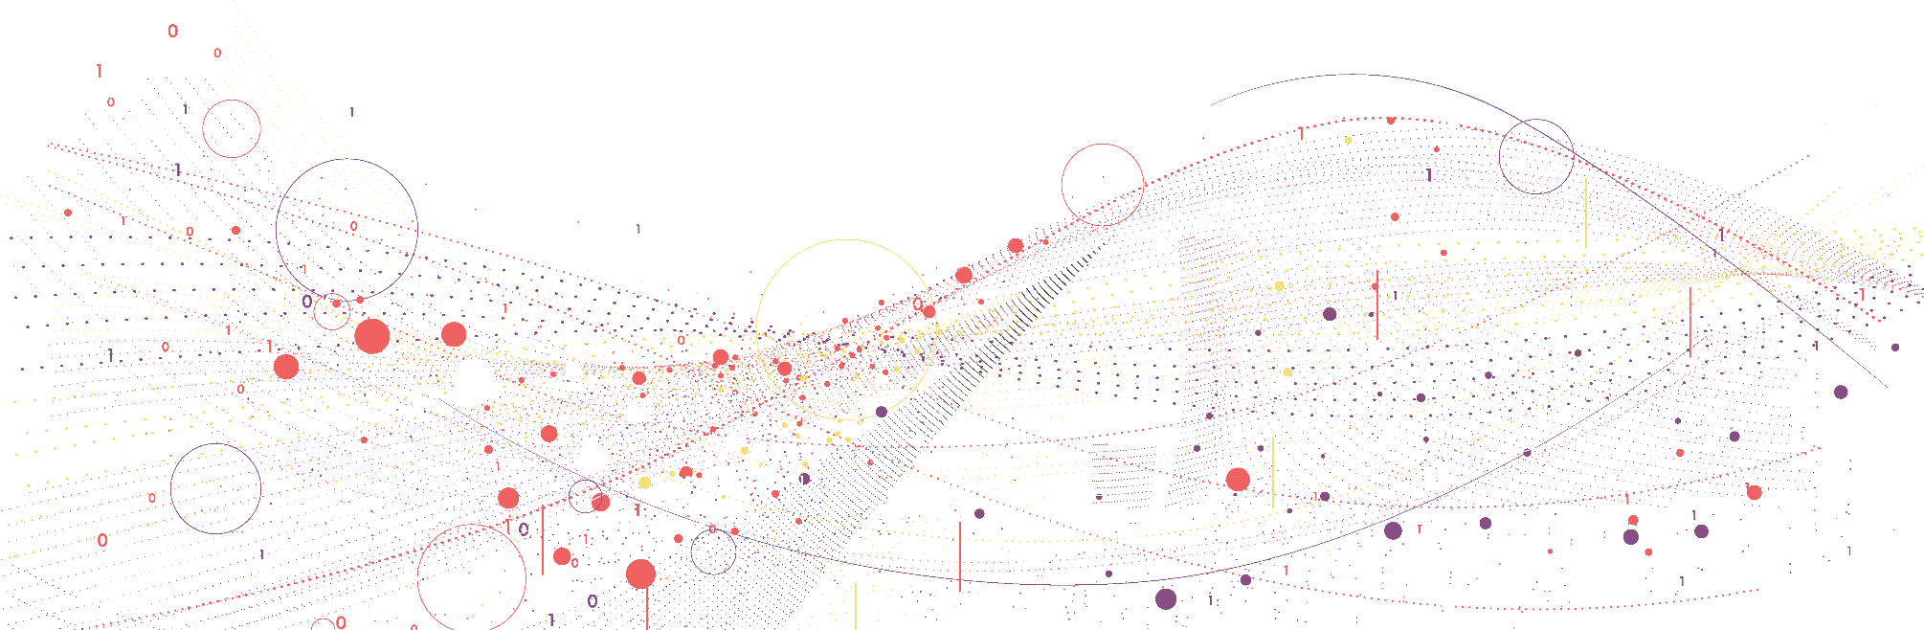

Program and Governance

Slide 12
Program Governance
LEVEL
CADENCE
KEY PARTICIPANTS
ROLE/RESPONSIBILITY
<Customer> Leadership: Executive Leadership
Onix Representatives: Account Executives
Set the priorities for the overall project
Act as a final escalation point for risks, issues & scope change
STEERING COMMITTEE
Monthly
OPERATING GROUP
Review and take key design decisions
Provide guidance on project roadblocks
Coordinate connections with appropriate groups
<Customer>: Business and Technology Leadership Teams
Onix: Delivery Lead, Appropriate Team Leads
Weekly (Discovery/Design)
Bi-Weekly (Build)
PROJECT MANAGEMENT
<Customer>: Project Manager, Support Team Leads
Onix: Delivery Lead, Project Manager, Appropriate Team Leads
Own overall delivery, accountability, and governance of the project
Review progress, debottleneck challenges, provide support
Publish project statuses
Weekly
DAY TO DAY TEAMS (EXECUTION)
<Customer>: Functional & Technical Support Teams
Onix: Technical Design Teams, Technical Development Teams, and Support Teams
Design infrastructure and technical requirements
Execute sprint plans
Design/Architect the overall solution
Flag risks and issues
~Daily

Slide 13




Onix Governance Model
Forum
Participants
Objectives
Frequency
Strategy and Planning | FAF Executive Leadership Onix Executive Sponsors Program Director Technical Director | Assessment of overall health of engagement, top-down proactive-set strategic direction and planning and strategic decision Business review Future partnership planning | Quarterly
Data Migration Office | Business Sponsor Program Delivery Lead Lead Solution Architect Change Lead | Define the migration strategy and governance Approve migration priority and budget Decisions to solve any specific issues, roadblocks | Monthly
Factory Meetup | Product Owners Program Manager Technical SMEs Operation Leads | Cross squad interactions where squads have dependencies across to manage their deliverables. Enable smooth integration and manage dependencies, risks, impediments. Resolve dependencies with existing Application Operations team Release management and deployment planning | Fortnightly
Migration Line Meetup | Scrum Masters Squad Roles | Day to day operations per Migration Line Agile (Kanban) Processes and governance | Daily
Strategic Level
Operational Level

Slide 14
Communication Plan
Kickoff Meeting
Frequency | Audience | Owner | Deliverable
Once at the start of the project | Project Sponsor | Project Team | Stakeholders | Project Manager / Technical Lead | Agenda Meeting Minutes
Introduce the project team, Review the project scope and proposed approach
Sprint Planning & Tracking
Frequency | Audience | Owner | Deliverable
Bi-Weekly | Project Sponsor Project Team | Project Manager / Technical Lead | Agenda Meeting Minutes Sprint plan
Review output of the sprint deliverable. understand the areas of improvement, if any.
Identify the stories to be included in the next sprint
Daily Scrum Calls
Frequency | Audience | Owner | Deliverable
Daily | Project Team | Project Manager / Technical Lead | Scrum Meeting Notes
Stand up calls to identify tasks for a particular day and identify bottlenecks if any
Weekly Status review
Frequency | Audience | Owner | Deliverable
Weekly | Project Sponsor Project Team | Project Manager / Technical Lead | Agenda Meeting Minutes Monthly status
Review output of the Weekly progress.. understand the areas of improvement, if any.
To Identify the stories to be included in the next month

Slide 15
Thank you.
For more information about the contents of this document please contact [email address].

Slide 16
Backup Slides

Slide 17
Option 2 : Migrate, Refactor,Develop & Modernize
~18 month engagement
Workstream | M1 | M2 | M3 | M4 | M5 | M6 | M7 | M8 | M9 | M10 | M11 | M12 | M13 | M14 | M15 | M16 | M17 | M18 | M19
Assessment, Design & Plan
Cloud and Data Platform foundation
Infra & Database Migration
App Migration & Refactor (Cloud SQL)
LakeHouse (BQ) + Snowflake to BQ + DBX Integration
ETL Modernization
AI Ready New Data model
New Data Model on AlloyDB with New Pipeline
App Modernization (New Data Model on AlloyDB)
BI Repointing + BI Modernization with BI to AI
Cloud & Data Observability
Change Management
Retire Azure & Informatica
Azure Decommission. Apps on CloudSQL
Cloudera
Snowflake
Retire old EDW
Informatica
Parallel Run with Old model and new model
~35 Apps are on AlloyDB with new data model
Legend | Milestone | Migrate & Modernize | Continuous Change Mgmt | SIT, Support & Warranty | Modernize (New Data Model on BQ and Alloy DB) | Modernize (Apps with New Data Model) | Optional Onix (Not priced)

Slide 18
WIP: Customer Efforts
Migration |  | Pricing ( USD)
Azure to GCP Migration (Infra/App) + Security | ** Volumetrics are listed in slide #9 | $xxx,xxx
 | SQL Server / MySQL / PostgreSQL / ADF ** Volumetrics are listed in slide #38 | $xxx,xxx
 | Databricks (Migration - rehosting on GCP + ADF) ** Volumetrics and assumptions are listed in “Databricks” slide | $xxx,xxx
 | Two SAP ECC Based environments 23 SAP Landscapes / 58 SAP systems | $xxx,xxx
Total Migration Budget |  | $2,260,989 - $2,712,088
Optional Component (Not in scope currently and not priced)
Cloud Managed Services |  | Price can be provided Deep Dive Workshop on expected SLA, OLA and Service Catalog discussion
Managed DataOps

Slide 19
Our Understanding
1 | Resource
2 | The
3 | AWS

Slide 20
WIP: Deliverables
1 | Technical Design Document
2 | CI/CD setup for foundation deployment and service provisioning
3 | Implementation of the cloud foundation
4 | Infrastructure as Code (IaC) for foundation deployment
5 | IaC code for deploying common GCP services

Slide 21
WIP: Customer Efforts
1 | 2 to 4 hour daily workshops during the first two weeks
2 | 1-hour workshops, twice a week, starting from week 3
3 | Hybrid connectivity design and implementation
4 | Review of the Technical Design Document
5 | Final validation of the implementation

